Slide 1

POMS.6240 analytical decision making tools lux* resorts & hotels
Mikhail joel Charles
Pranay rai
Pavani narla

Slide 2
1: overview & Problem Statement
lux* resorts & hotels
LUX* Resorts & Hotels faces the challenge of optimizing its room mix strategy across various seasons and locations to achieve its EBITA target from foreign guests while maximizing revenue from residents.
Achieve the €38 million EBITA target from foreign guests across 10 hotels. Determine the net revenue contribution from local guests to fund corporate social responsibility programs.
Optimize room mix strategy to balance occupancy and revenue generation across seasons and hotel locations.

Slide 3
2: Background Facts
lux* resorts & hotels
Founded as Naiade Hotels, faced financial struggles, rebranded as LUX* Resorts & Hotels with a focus on guest satisfaction and innovation, operates 10 hotels across multiple locations, prioritizes unique experiences and social responsibility.
Hospitality industry characterized by seasonal demand fluctuations, varying room pricing strategies, and evolving consumer preferences towards experiential stays.

Slide 4
4: Methods
lux* resorts & hotels
Model Used:
The model used is Linear Programming (LP)
Objective Function:
Determine the optimal mix of rooms across its 10 hotels to achieve the targeted EBITA Total Revenue of €38 million and maximize revenue from foreign guests.
Maximize net revenue generated from local guests.
Decision Variables:
LUX* hotels at all locations (foreign guests)
LUX* hotels in Mauritius (local guests)

Slide 5
4: Methods - (Continued)
LUX* RESORTS & HOTELS
Constraints:
Foreign Guests:
1) EBITA Target Constraint
2) Maximum Room Occupancy at Night
3) Minimum Room Occupancy
Local Guests:
1) Room availability for local guests Post International Bookings
2) 50% discount on the average room revenue(ARR) of foreign guest prices to local guests.

Slide 6
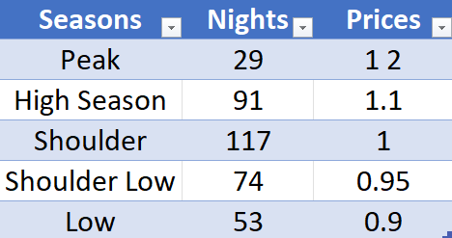
4: Methods - (Continued)
LUX* RESORTS & HOTELS
Pricing Strategy for Different Seasons:

Slide 7
4: Methods - (Continued)
LUX* RESORTS & HOTELS
Assumptions
Explicit:
Known Demand
Set Prices
Limited Rooms
Implicit:
Operational Uniformity
Market Stability
Resource Availability

Slide 8
4: Methods - (Continued)
LUX* RESORTS & HOTELS
Strengths of this model:
Allows for adjusting prices in response to demand fluctuations, potentially maximizing revenue during peak times and maintaining occupancy during slower periods.
Focuses on maximizing total revenue by considering various factors like demand, pricing, and capacity constraints.
Weakness of this model:
Linear models and assumptions may oversimplify the complexity of hotel operations and market behaviors.
Relies on fixed assumptions about demand, pricing elasticity, and operational capacities.

Slide 9
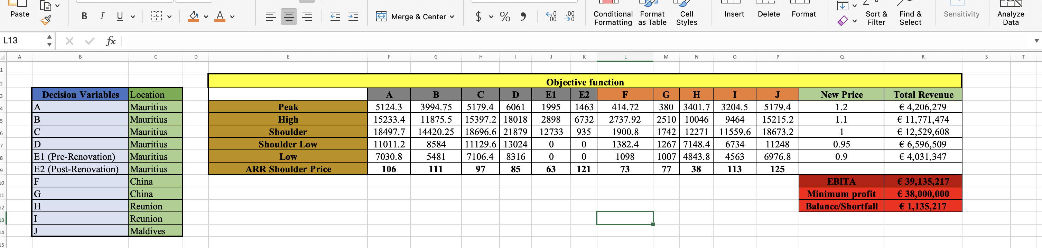
5: Results
lux* resorts & hotels

Slide 10
As you can the we have the decision variables, which from A to E2 are the Mauritius Locations and F-G are various locations including China, Maldives and Reunion.
Also we can the objective function including, EBITA, Min profits and the Deficts/Surplus amount. All those results were calculated using solver.

Slide 11
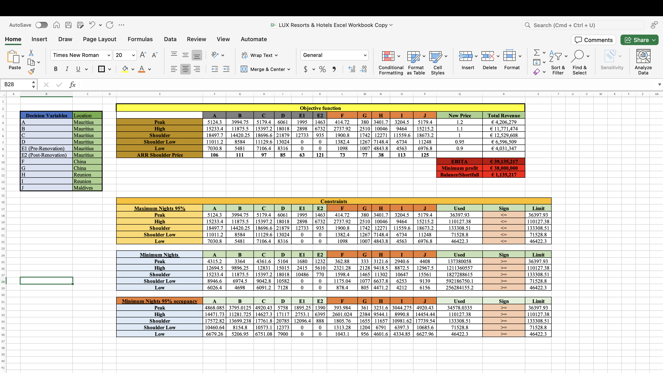

Slide 12
As you can see this table shows both constraints for foreign guest and the local guest. Also, in this table it shows the maximum nights for each locations for each foreign and local guest in individual season.
As you can see at the table, our target is max occupancy which is why we have 95% occupancy rate and at the table below represent the minimum nights that needs to sold to foreigner guest each season.

Slide 13
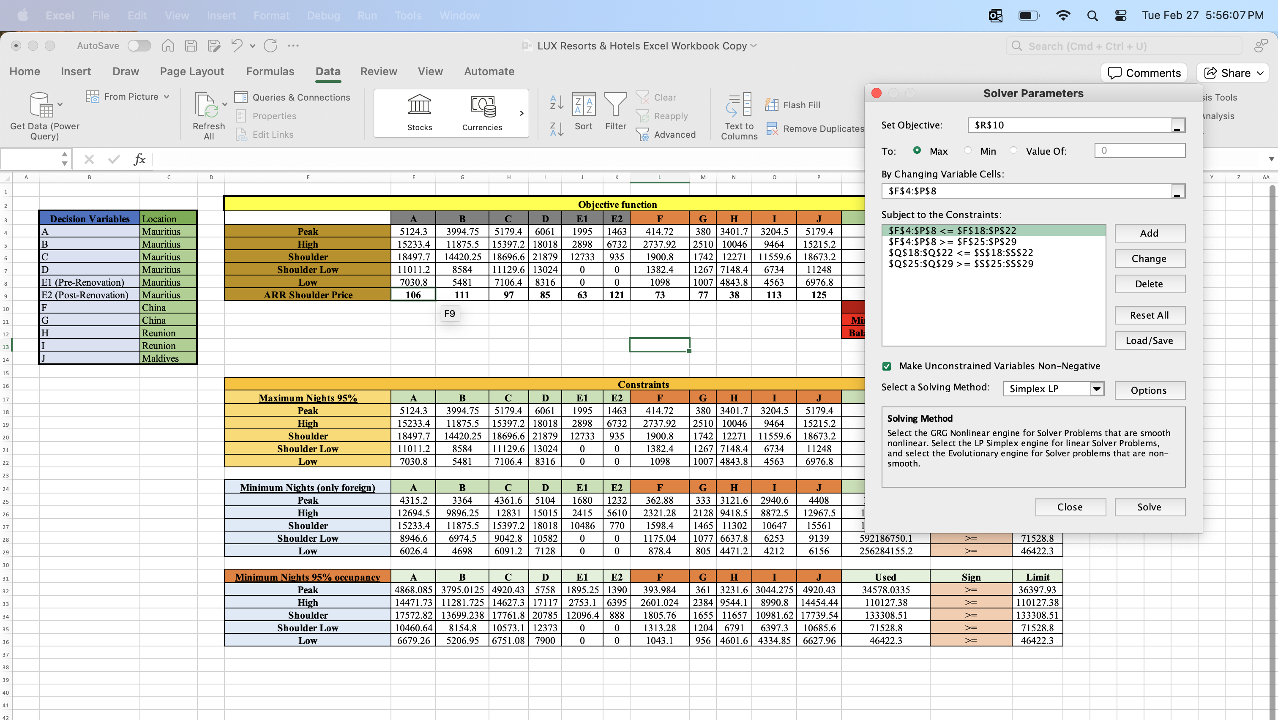

Slide 14
First we look at the our objective function we used solver to get those numbers.
As we are trying to keep our occupancy rate at 95% as per case studies our objective function cannot exceed the maximum number of nights. For instance if our objective functions we have 5124.3 days available during peak season that cannot exceed number in our maximum occupancy rate as I mention before because we are trying to compute max.
Similarly, for minimum nights we have constraints to selling at least 4315.2 days to generates the revenue. This is also another constraints to generate revenue by selling the number of that days to foreign guest.
After using solver as you can see we get EBITA of 39 millions euro which compare to our target profit of 38 million euro we manage to have surplus of 1.1 million pounds which indicates profits for lux hotels in foreign guest.

Slide 15
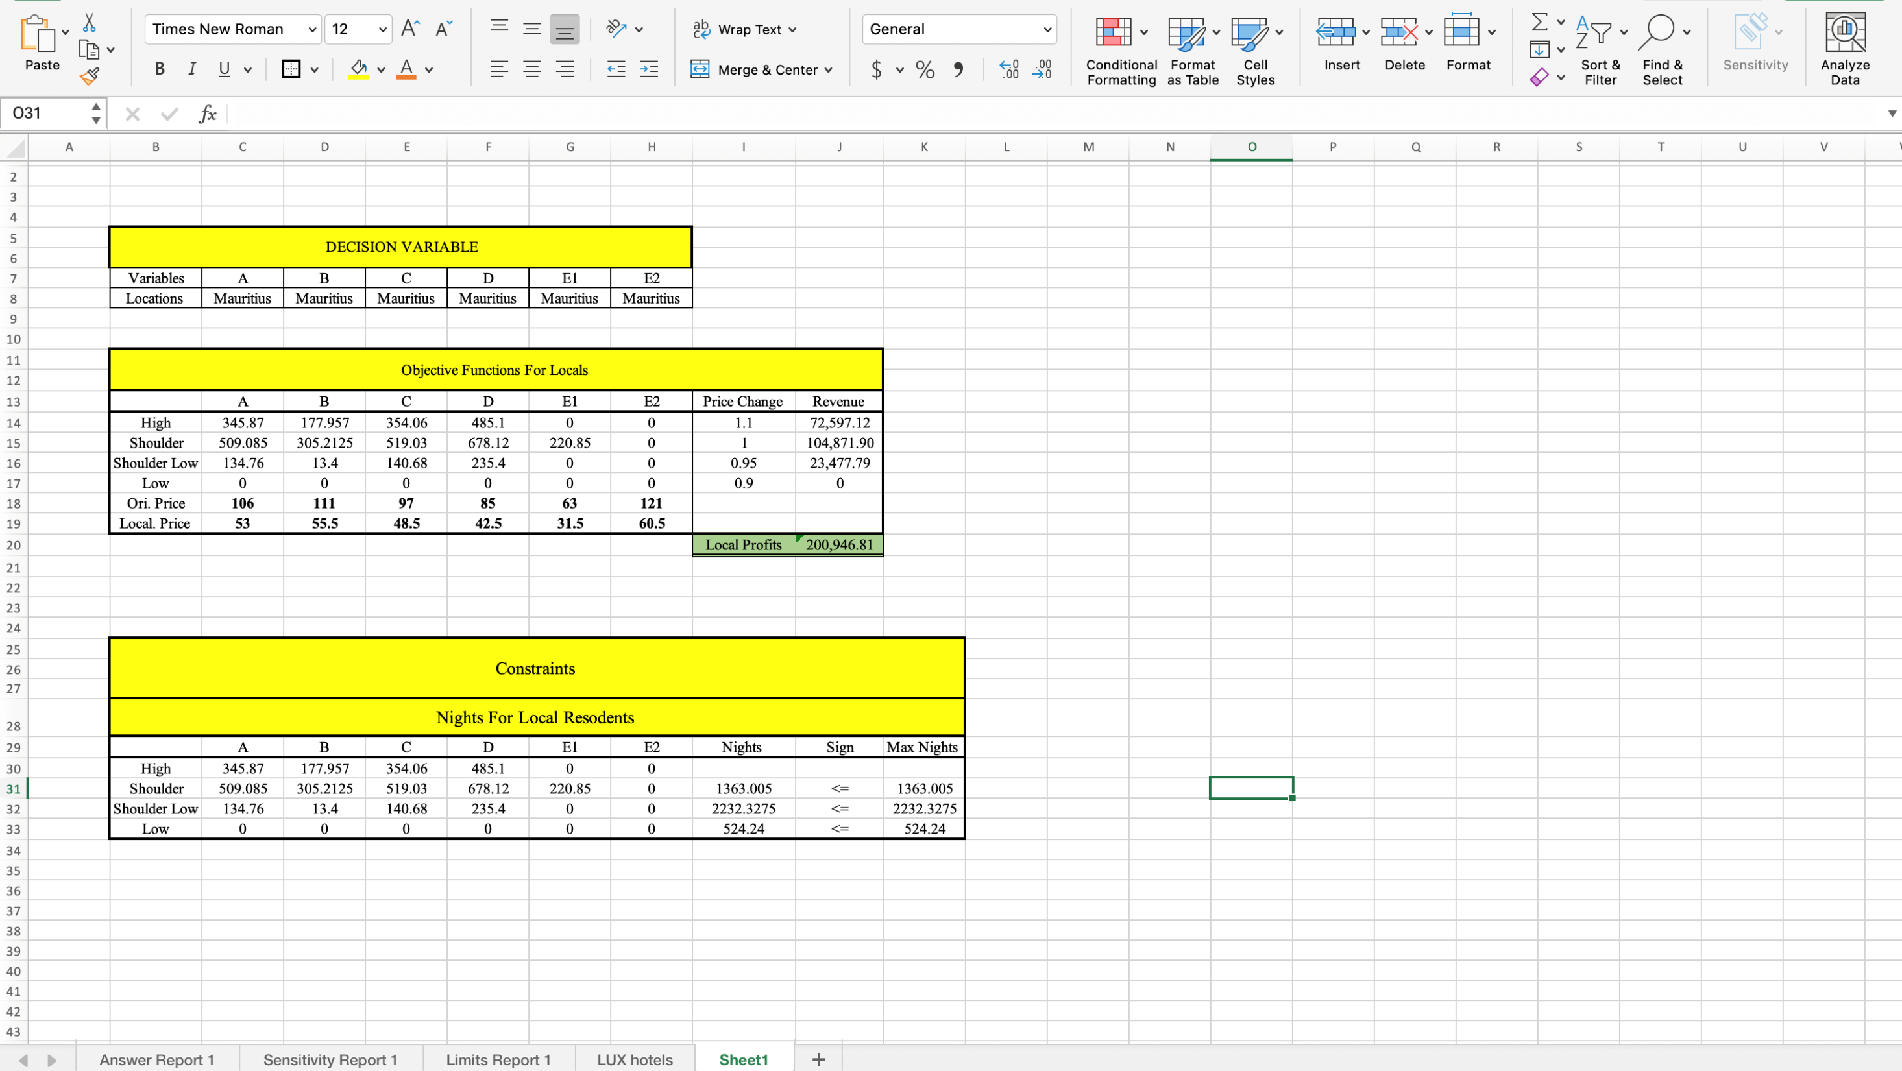

Slide 16
What we did was we looked at all the empty rooms that were unsold to the foreign customers and give them to local in discounts rate to see how much revenue that will generate.
As shown in the table different between original price and local price, where we discounted the price from original price after running the solver putting constraints of given maximum nights not exceeding given night. From that we got 200,946.81 pounds of revenue.
3. Managements can exploits this finding and use in their advantage.

Slide 17
Recommendations
lux* resorts & hotels; Recommendations
Reach the and tap into local market which according to our finding it can generate significant revenue.
And even sell the available rooms in discounts rate as, even if they sell rooms to local there still will more plenty more.

Slide 18
6: Summary and Conclusions
lux* resorts & hotels
To Maximize the revenue selling nights available to foreign guest
Reach and tap into local market which according to our finding it can generate significant revenue.
- We used linear optimization model
- Focusing on maximizing revenue

